Slide 1

Incentives Matter!
Our plan to reduce TTC CO2 Emissions by >5%
Rishi Kar, Eugene Kim, Curtis Chong, Shabs Badsha

Slide 2
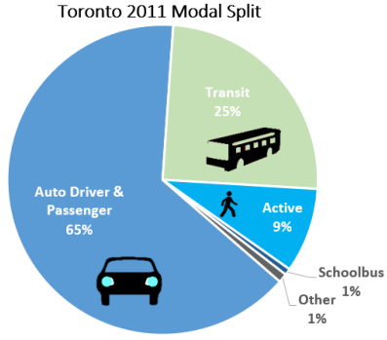
Introduction
Public Transit accounts for 25% of daily commutes - over 1.5 M rides!

Slide 3
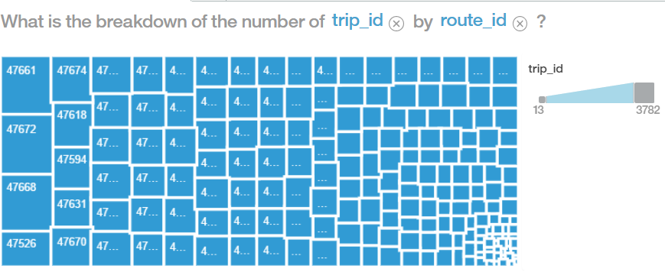
Current Issue / Background
From the data, we found the frequency of trips per route

Slide 4
Data results
Predicting current CO2 emissions (Kg/km) for each transport method.
Parameters:
Type of Transport Streetcar, Subway, Bus
Distance travelled
Rate of CO2 emissions per kilometer travelled

Slide 5
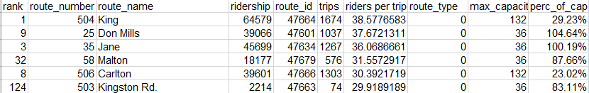
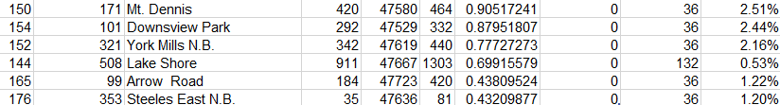
Data Parsing
Using TTC provided data, we found the number of riders, maximum capacity, and distance travelled for each TTC route.
Most rider percentage of capacity
Least rider percentage of capacity

Slide 6
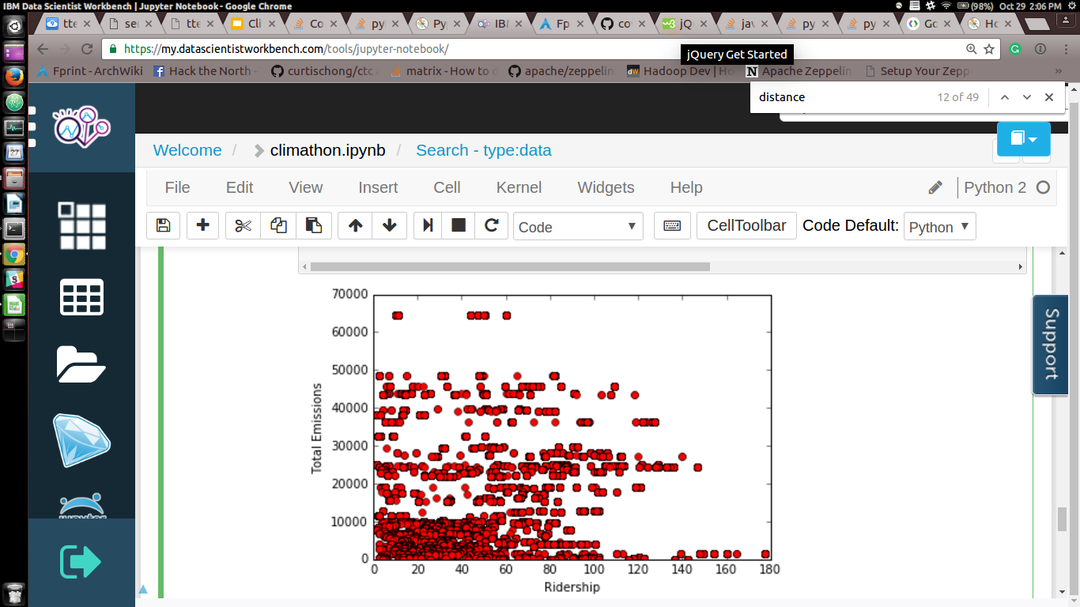
Distribution of CO2 Emissions

Slide 7
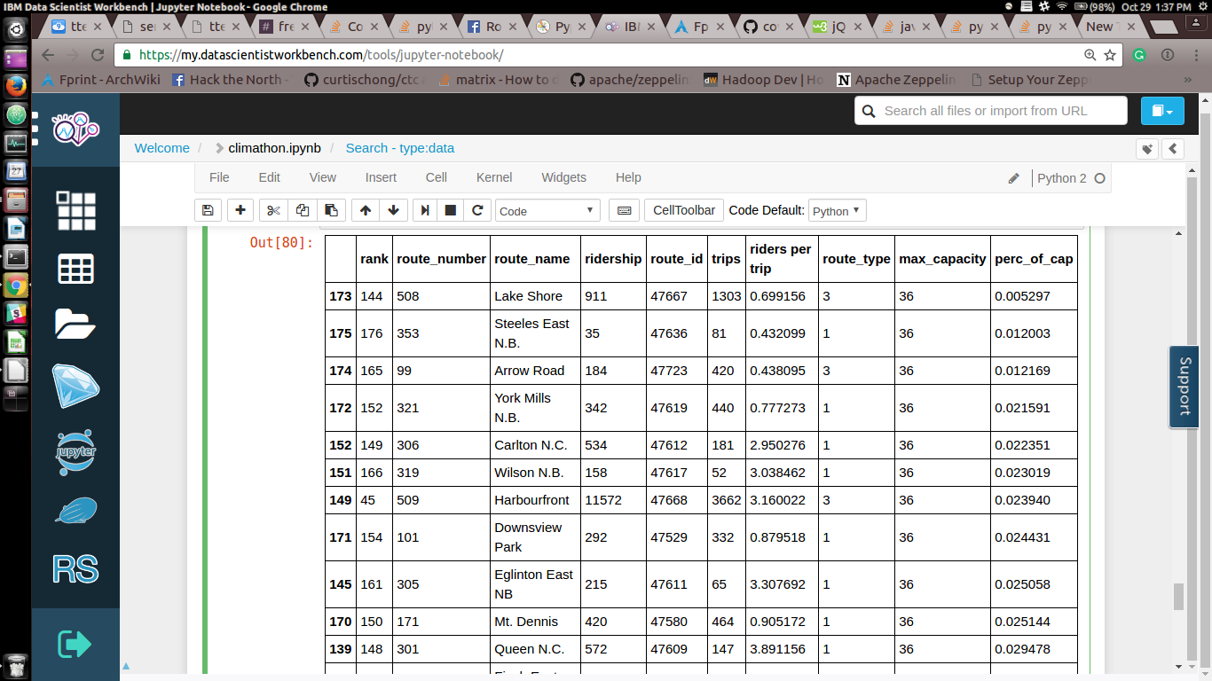
Least Efficient Routes

Slide 8
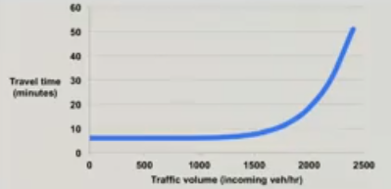
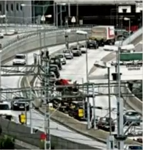
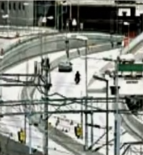
Are incentives effective?
TedX on “How to Solve traffic jams” - Adding a small fee ($1) caused traffic to go down by 20% leading to less congestion (non-linear)
Similarly, adding a discount may make more people choose taking the TTC over driving
More People will be incentivized to ride bus/ subway/ streetcar more so that it will be cost-neutral

Slide 9
Our Proposal
Classifying the routes that are saturated and underutilized
Optimize the frequency of underutilized routes
Offer incentives for using underutilized routes
Add alternatives for more capacity for saturated routes
Launch an App to show capacity utilization and carbon impact

Slide 10
Methods of Reducing CO2 Emissions
Adding App functionality to target the routes with high percentage of capacity utilization (>80%)
Cutting routes or adding incentives to use routes with low percentage of capacity underutilization(<15%)

Slide 11
DEMO
TTEZ RIDE

Slide 12
Benefits
Lower commute times for using public transport
Lower commute cost (for underutilized routes)
Decreasing our Carbon Footprint through route reductions

Slide 13
Statistics
In 2013, TTC reported ~ 159g CO2 / km* is produced per passenger
On average, the amount of CO2 emission produced
by underutilized routes:
30.7 kg CO2 / 6.6 km = 4.65 kg CO2 / km
We would be able to reduce the CO2 emissions by...
(0.159kg CO2/km / 4.65kg CO2/km)
*TTC Sustainability Report 2013

Slide 14
3.42%

Slide 15
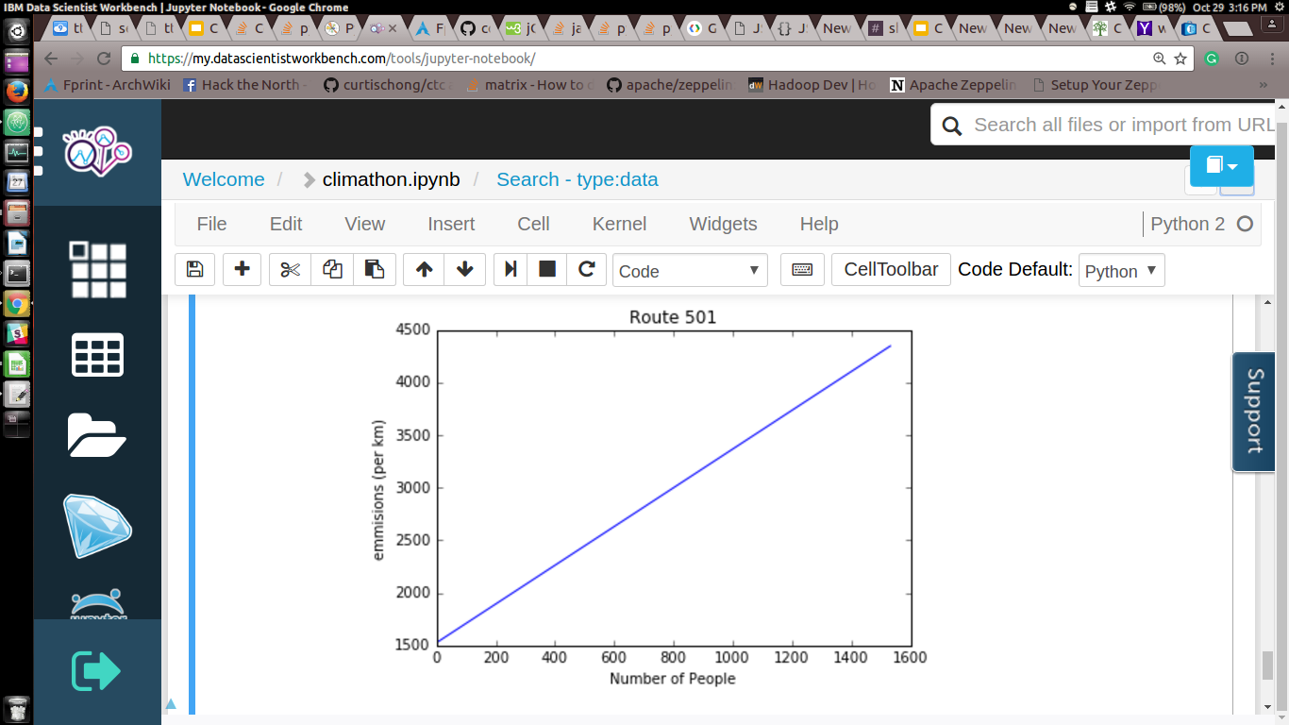
Amount of C02 (Kg)

Slide 16
Statistics
At max capacity:
Subway (Line 1) trip from King St to Eglinton Ave used 30.7 kg CO2.*
Calculating per customer, per km: 30.7 kg / (6.6 km x 384 people)
For subway: 12.11 g CO2 /km
For streetcar: 35.26 g CO2/ km
For bus: 87.81 g CO2/km
Assumptions:
Similar gas consumption for g CO2/km for all transport methods.
Idle times are negligible
Maximum capacity
*TTC Sustainability Report 2013

Slide 17
QUESTIONS
THANK YOU

